Slide 1


SCREEN SUCCESS:
ANALYZING TV SERIES DATA DYNAMICS
Team 1
Han Nga Chan, Jinke Han, Min Xu
Mingze Wu, Yiming Wang
Notes:
①mit

Slide 2




Guiding producers toward crafting successful TV series that set them apart from competitors
Enabling them to achieve business goals and yield significant returns on their investment
Comprehensive resource for producers and investors planning to venture into the creation of new TV series.
BUSINESS VALUE
Notes:
①

Slide 3

DATASET
TABLE NAME
DESCRIPTION
name.basics | Information about people in the entertainment industry
title.akas | Alternative titles for titles in different regions and languages
title.basics | Information about titles, including type, primary title, release year, and genre
title.crew | Lists the directors and writers associated with specific titles
title.episode | Describes the relationship between TV seres and their episodes
title.principals | Details the individuals and their roles invovled in the TV industry
title.ratings | Ratings and vote counts for titles
The dataset is from the “Internet Movie Database (IMDB) Developer”
Includes data from 1930 to 2020s
Notes:
①
data set
data source

Slide 4


KEY DIMENSIONS FOR SUCCSS
TIME DYNAMICS
Analyzing the time cycle from the production to the release of TV series, exploring the impact of timing on the success of TV series.
GENRE ANALYSIS
Identify specific trends and preferences that assist genre selection and development of new series for aligning content creation with the evolving tastes of audiences.
REGIONAL INFLUENCE
Assessing how geographical and cultural factors contribute to the success of TV series for different audience groups.
PRODUCTION CREWS
Exploring the composition and experience of production teams to determine how these elements correlate with the quality and success of TV series.
Notes:
②min
1. 文字是否需要每段变成一句话
2. 标题横过来，改名
3. 四段文字交叉排列

Slide 5





TIME DYNAMICS
Notes:
②

Slide 6

GREATER NUMBER OF SEASONS ≠ SUPERIOR RATINGS
Series Name | Total Seasons | Average rating
Dogru Kariyer | 1 | 10
Meet Yourself | 1 | 9.98
Yabanci Damat | 3 | 9.87
TRENDS FOR TV SERIES WITH ALL TIME HIGHEST RATINGS
Series Name | Total Seasons | Average rating
Last of the Summer Wine | 31 | 7.75
Taggart | 27 | 7.43
Doctor Who | 26 | 7.28
PATTERNS OF TV SERIES WITH ALL TIME MOST SEASONS
Notes:
②

Slide 7
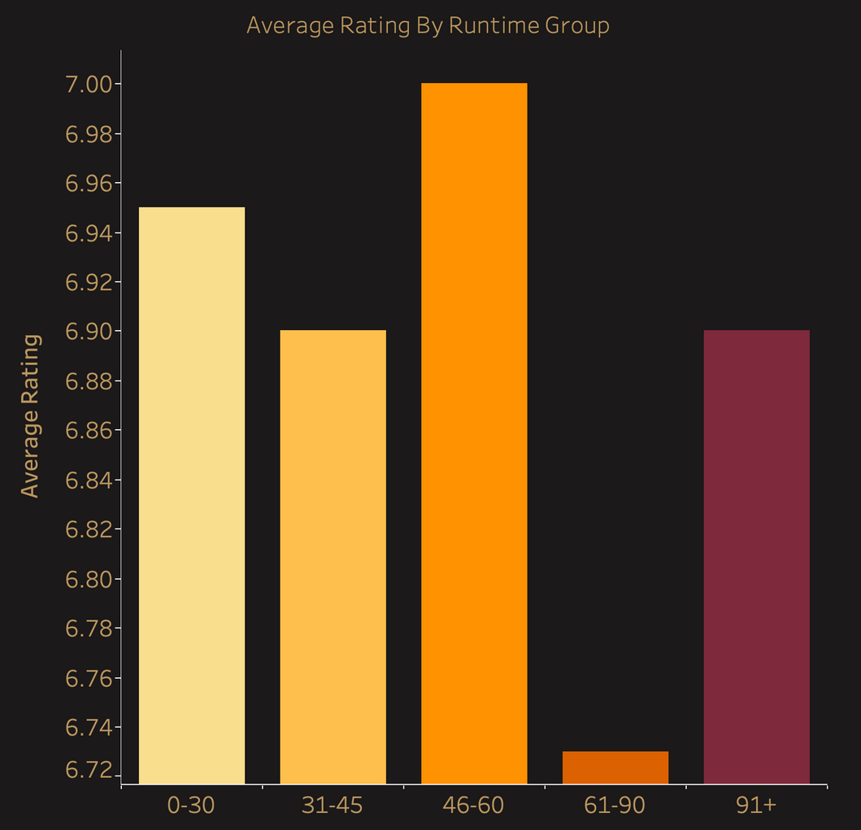


RUNTIME UNDER 30 MINUTES OR BETWEEN 45 TO 60 MINUTES
Runtime Group
Notes:
②
这里切入DB

Slide 8

GENRE SELECTION
Notes:
③kelly

Slide 9


Ratings
BEST PERFORM GENRE
1
War
7.77
48,740,131
Voting
1
Crime
7.27
3,488,969,703
2
History
7.54
172,873,705
2
Drama
7.25
1,442,170,251
3
Western
7.54
18,756,521
3
Comedy
7.1
1,438,225,693
HORROR
DRAMA
DRAMA
1940s
1960s-1990s
1930s
WESTERN
1950s
COMEDY
2000s-2020s
TOP GENRE CHOICE FROM 1930S TO 2020S
Notes:
③

Slide 10



TOP 3 GENRES IN EACH CONTINENT
Europe:
Drama
Comedy
Crime
Asia:
Drama
Comedy
Animation
Africa:
Drama
Comedy
Crime
America
Drama
Comedy
Animation
Oceania:
Drama
Comedy
Crime
Antarctica:
Family
Comedy
Animation
Notes:
③

Slide 11
REGIONAL INFLUENCE
Notes:
④yiming

Slide 12
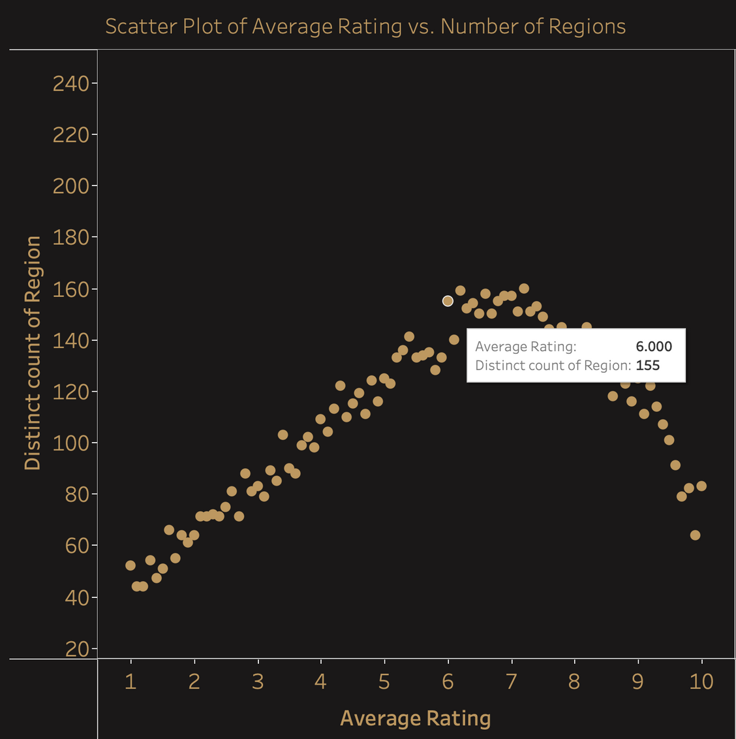


Scatter Plot of Average Rating vs. Number of Regions
LANGUAGE CHOICE
OFFICIAL OR PRIMARY SPOKEN LANGUAGE
Tunisia: French (Previous Colonies of France)
India: Gujarati (Third place in India)
Comprehensive research is essential to accurately target specific audiences
Average Rating
AIRING TV SERIES ACROSS WIDER REGION HAS HIGHER RATINGS
Notes:
④

Slide 13
PRODUCTION CREWS
Notes:
④

Slide 14
OBTAIN EQUALLY HIGH QUALITY CREW MEMBERS
CASTING, FINDING SUITABLE MUSICIONS, AND WRITERS
SUPPORT
ACTORS
SOUND
WRITER
ACTRESSES
VISUAL/EDITOR
MUSIC
Notes:
④
重新排版文字
可以把排在前面的字体放大，排在后面的依次缩小

Slide 15

INVOLVE IN MORE PRODUCTION
≠
HIGHER RATINGS
Name | No. of roles | Average rating
Dave Dedrick | 1 | 9.80
Sudhir Joshi | 1 | 9.70
Rasika Joshi | 2 | 9.70
ACTORS/ ACTRESS WITH THE HIGHEST AVERAGE RATINGS
Name | Occurrences | Average rating
Don Messick | 92 | 6.76
John Stephenson | 63 | 6.79
Hal Smith | 52 | 6.96
PEOPLE PARTICIPATED IN HIGHEST NUMBER OF PRODUCTION
Notes:
④

Slide 16

CONCLUSION - QUALITY OVER QUANTITY
TIME LENGTH
Crafting single-season shows or ensuring quality across multiple seasons
Episodes should be under 30 minutes or between 45 to 60 minutes.
GENRE SELECTION
Drama, Comedy and Crime genres secure high ratings and broad audiences.
War, historical, documentary, and biography, while also earning high ratings
Drama and comedy historically dominate as the most popular genres
REGIONAL ANALYSIS
Higher-rated shows are generally aired in more regions
Highest-rated TV series are in the official or most commonly spoken language.
PRODUCTION CREWS
Prioritizing casting, music, and writing
Select actors dedicated to a single project and fitting for their roles
When choosing other crew members, prioritize quality over quantity
Notes:
⑤cherry
结论
present 时最后强调一下BUsiness Values

Slide 17



HUGE DATASET RESTRICT UNDERSTANDING OF DATA
IMBALANCE IN RATINGS AND NUMBER OF VOTE
CHALLENGES
Implementing a weighted rating system
Give more weight to shows with more votes
Balancing the influence between fewer votes but higher ratings and those with a larger number of votes
Export Data to Big query and Jupyter notebook allow thorough investigation
More in-depth understanding about the data
UNABLE TO IDENTIFY INVALID COUNTRY CODE
Assumed that the 2-character country codes were mostly accurate
Focused on country codes with more than 3 characters for validation
Ultimately identifying and filtering out 8 invalid country codes
Notes:
⑤
加个标题

Slide 18

THANK YOU
Notes:
⑤

Slide 19

QUESTIONS
Notes:
⑤

